Slide 1
My sweets
Made by Gréta Mizsei
Mátyás Molnár Primary School of Vaja
Class 8a

Slide 2
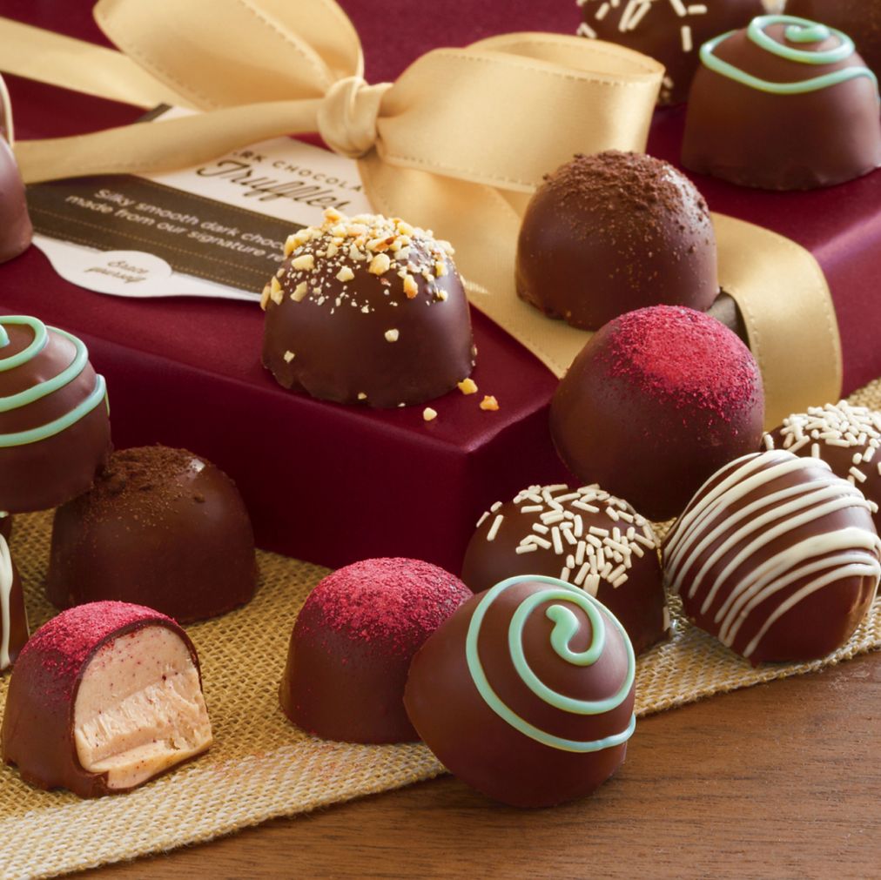
Did you know?
Chocolate is good for your thinking and most people, who got Nobel prize, eats chocolate.
Well, chocolate is better than other sweets for your teeth, too, because it doesn’t stick on them.☺ ☺

Slide 3
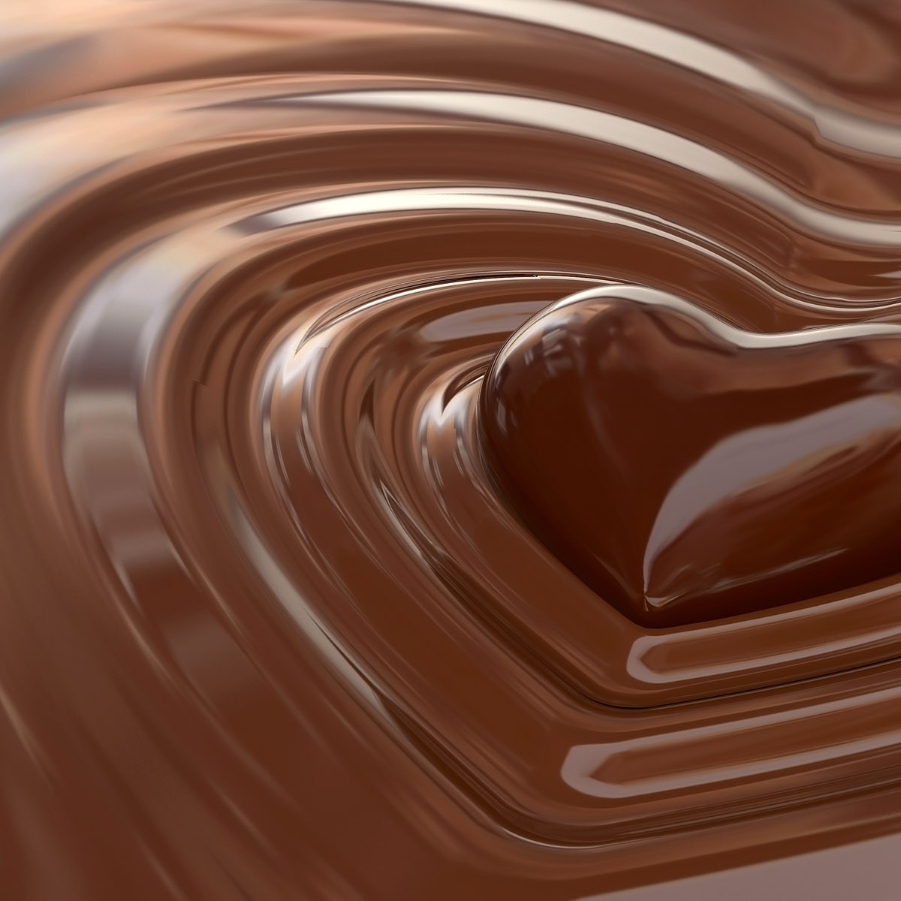
The day when much more chocolate is sold than ever
Many people think that the NO1. chocolate day is Valentin’s day. To tell the truth, more than 36 million heart-shaped boxes of sweets are eaten that day, but in real other holidays like Christmas,Easter and Halloween are bigger events of that.

Slide 4
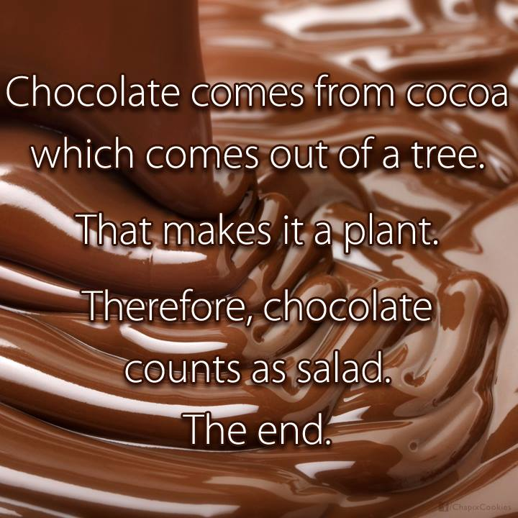
how many chocolate is healthy?
There are so many chocolates but the healthiest on the list is the dark one.
It’s good for your cardiovascular system, but you need to be careful with it, because you can be fatter and fatter if you eat too much of it.

Slide 5
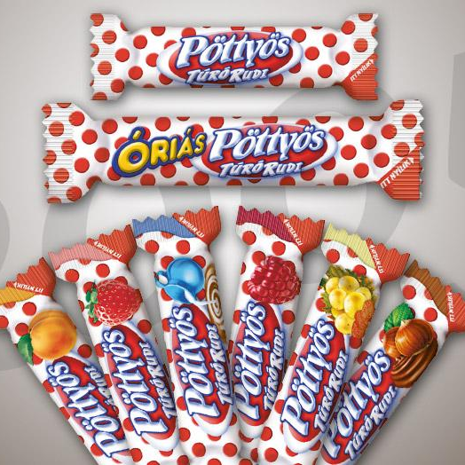
Our hungaricum:
The pöttyös Túró rudi
Dots are already 46 years old now and it took 12 years to develop the perfect recipe. The first little brown stick was born in 1963 and made from curd cheese rolled in chocolate. The main producers Danone and Friesland keep their recipes for Túró Rudi the biggest secret ever.
You can buy other similar desserts, too,
but they aren’t the same as the real one ☺

Slide 6
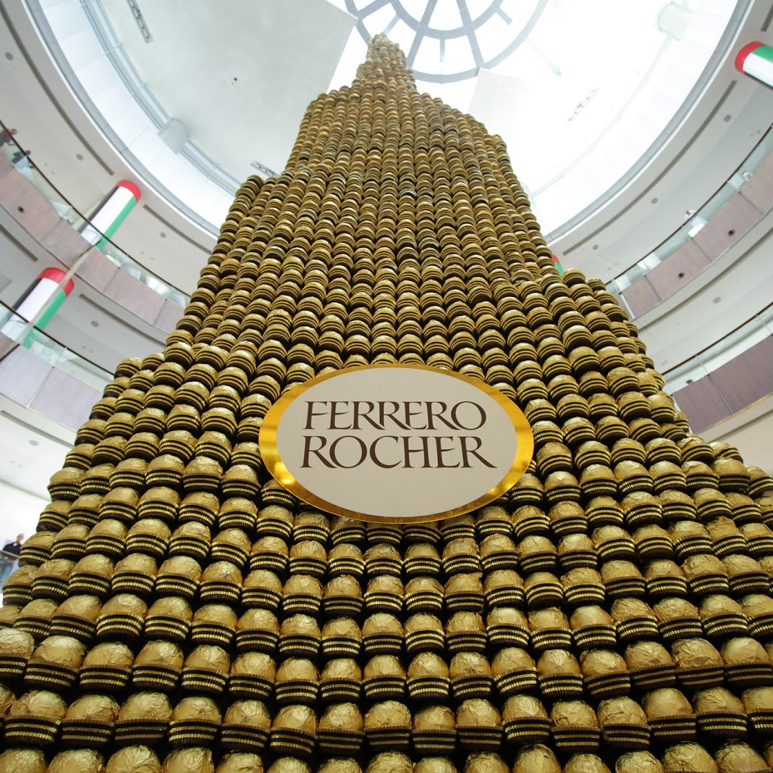
The No1 chocolate
From the 1940’s Pietro Ferrero developed a wide variety of confections that are sold first in Italy, other European countries, then to other countries throughout the world.
Ferrero Roche has distinctive gold foil wrapper, unique premium packaging and high quality hazelnut balls.

Slide 7
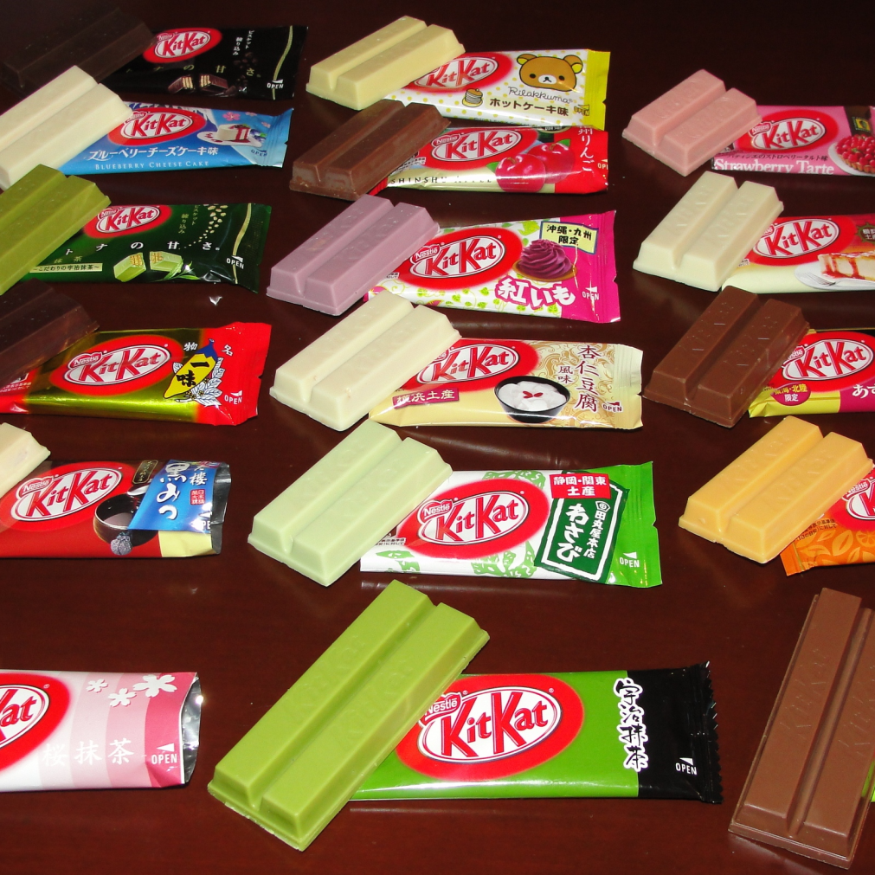
Did you know?
KitKat wasn’t originally the name of this chocolate but a certain pie which was served in the 18th century in a political Kit-Cat Club in London.

Slide 8
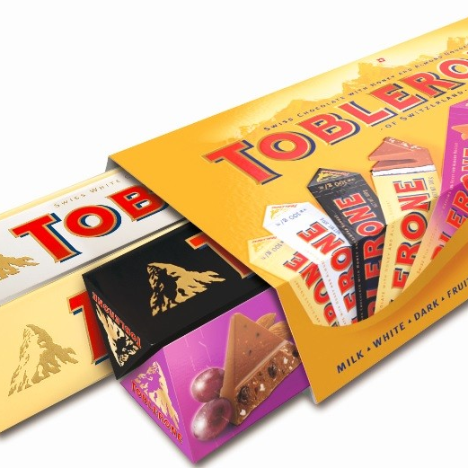
The bears’ chocolate
Toblerone was created by Theodor Tobler.
It is a unique milk chocolate including nougat, almonds and honey with a triangular shape. The logo contains a bear, the emblem of the city.

Slide 9
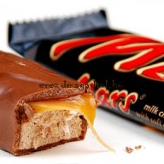
Go to the mars!
The Original Mars bar was in "Believe" packaging and not many years ago it got the name of Mars showing that the producers support the English national
football team.☺

Slide 10
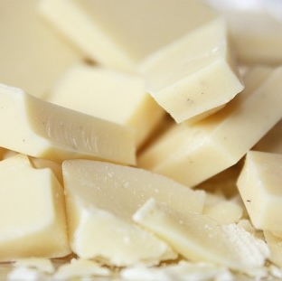
The white chocolate’s secret
Why is the white chocolate white? Because it has only cocoa butter, so it’s called chocolate, but it doesn't contain any cocoa solids.

Slide 11
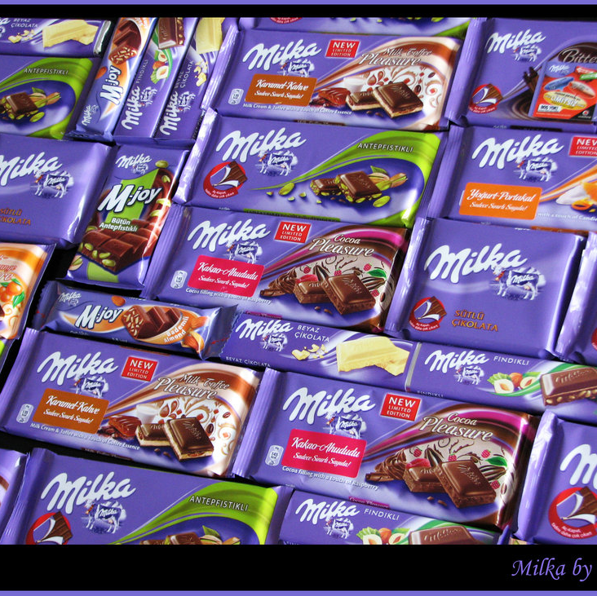
My favourite
Chocolate:
Milka
The company sells about 430 million bars, bears and Santas a year. This chocolate’s main characteristic is its purple cow.
It first appeared in 1973 in an advertisement. Since 1973 the purple cow was in 110 television advertisements.

Slide 12
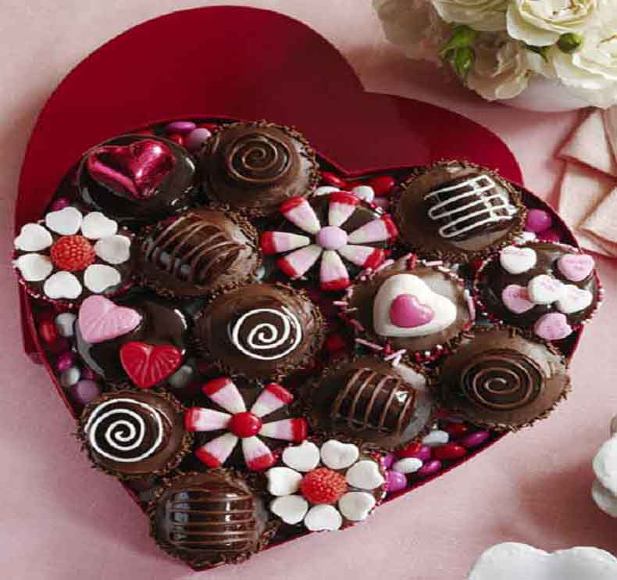
A good advice to the chocolate eaters
It is not a problem if you like chocolate and sometimes eat a bar, but you need to be careful because you can become a chocolate veding machine and won’t be able to quit of it. So, do not become addicted to it and you should learn how to say ‘no’ for it.

Slide 13

Thank you for watching my presentation. hope you enjoyed it. ☺

