Slide 1
Me and my jeans

Slide 2
1. Fashion for every season from basic denim clothes?
2. How to wear denim and it’s part in fashion
3. Find your style! Quick quiz

Slide 3
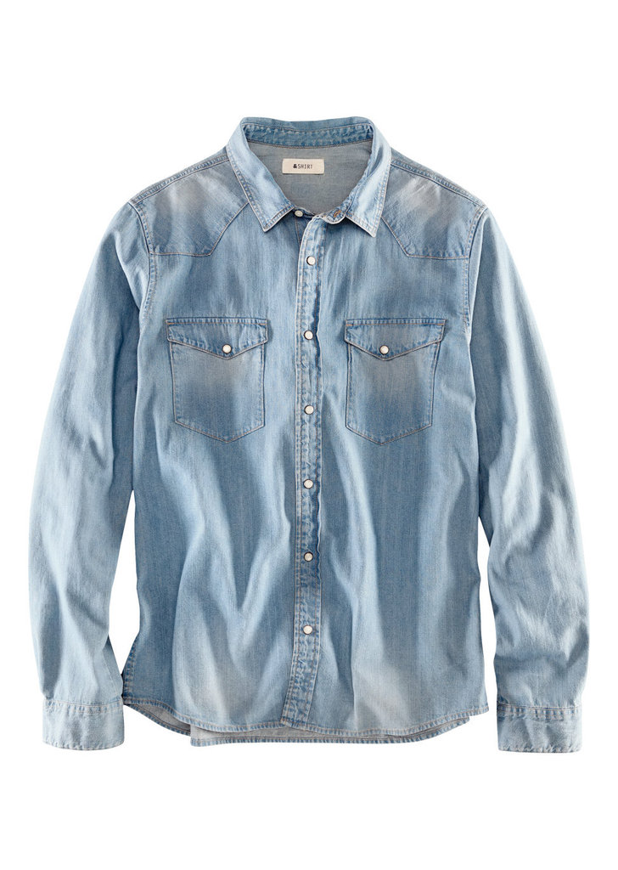
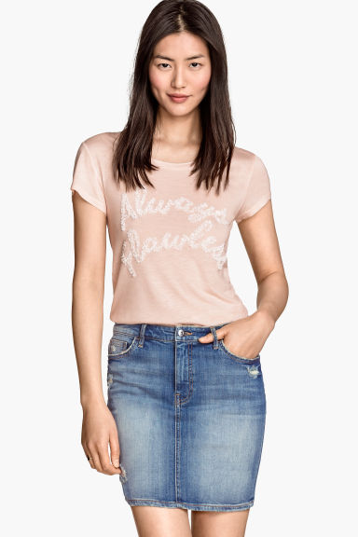
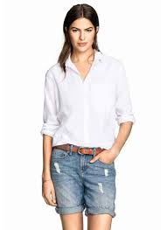
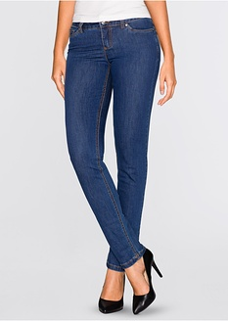
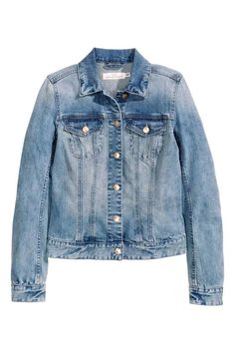
List of items I own:
-Jeans, shorts
-Giubbotto jeans
-Dresses made out of denim
-denim skirts
-Shirts made out of denim

Slide 4
Spring and summer wear ideas
A light denim dress
Denim vest with shirt and gloves or jacket (optional)
A denim short with a warm & cozy stockings
A comfortable gardener styled dress
A denim capri pant styled trousers with long socks & thick, baggy sweater
A trendy denim short

Slide 5
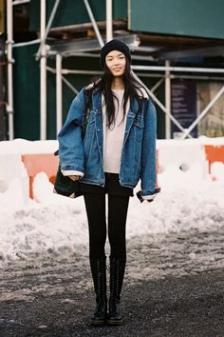
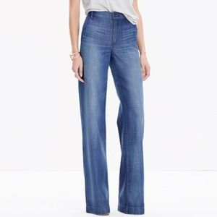
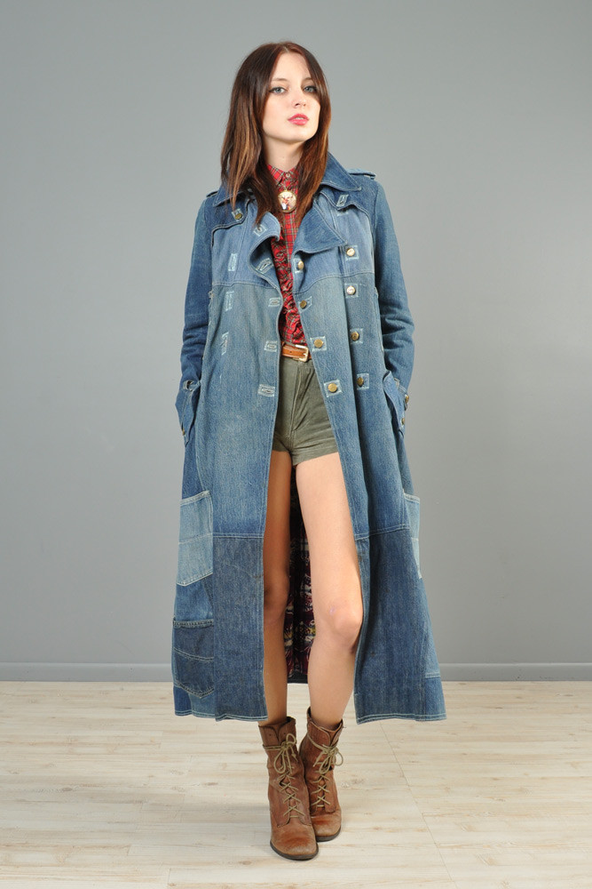
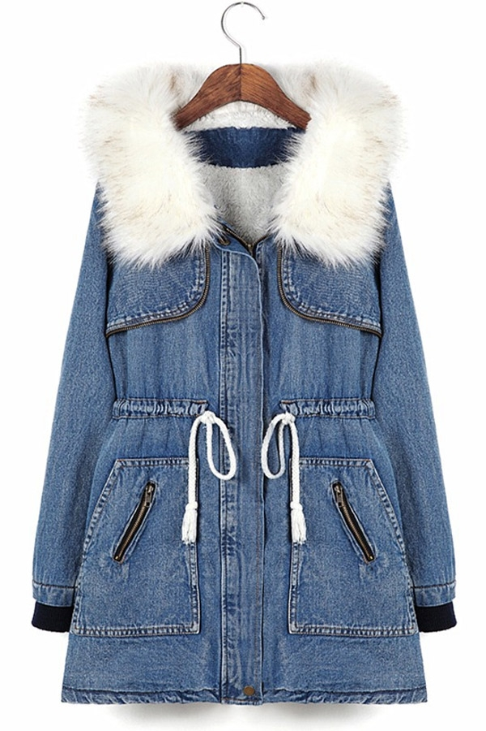
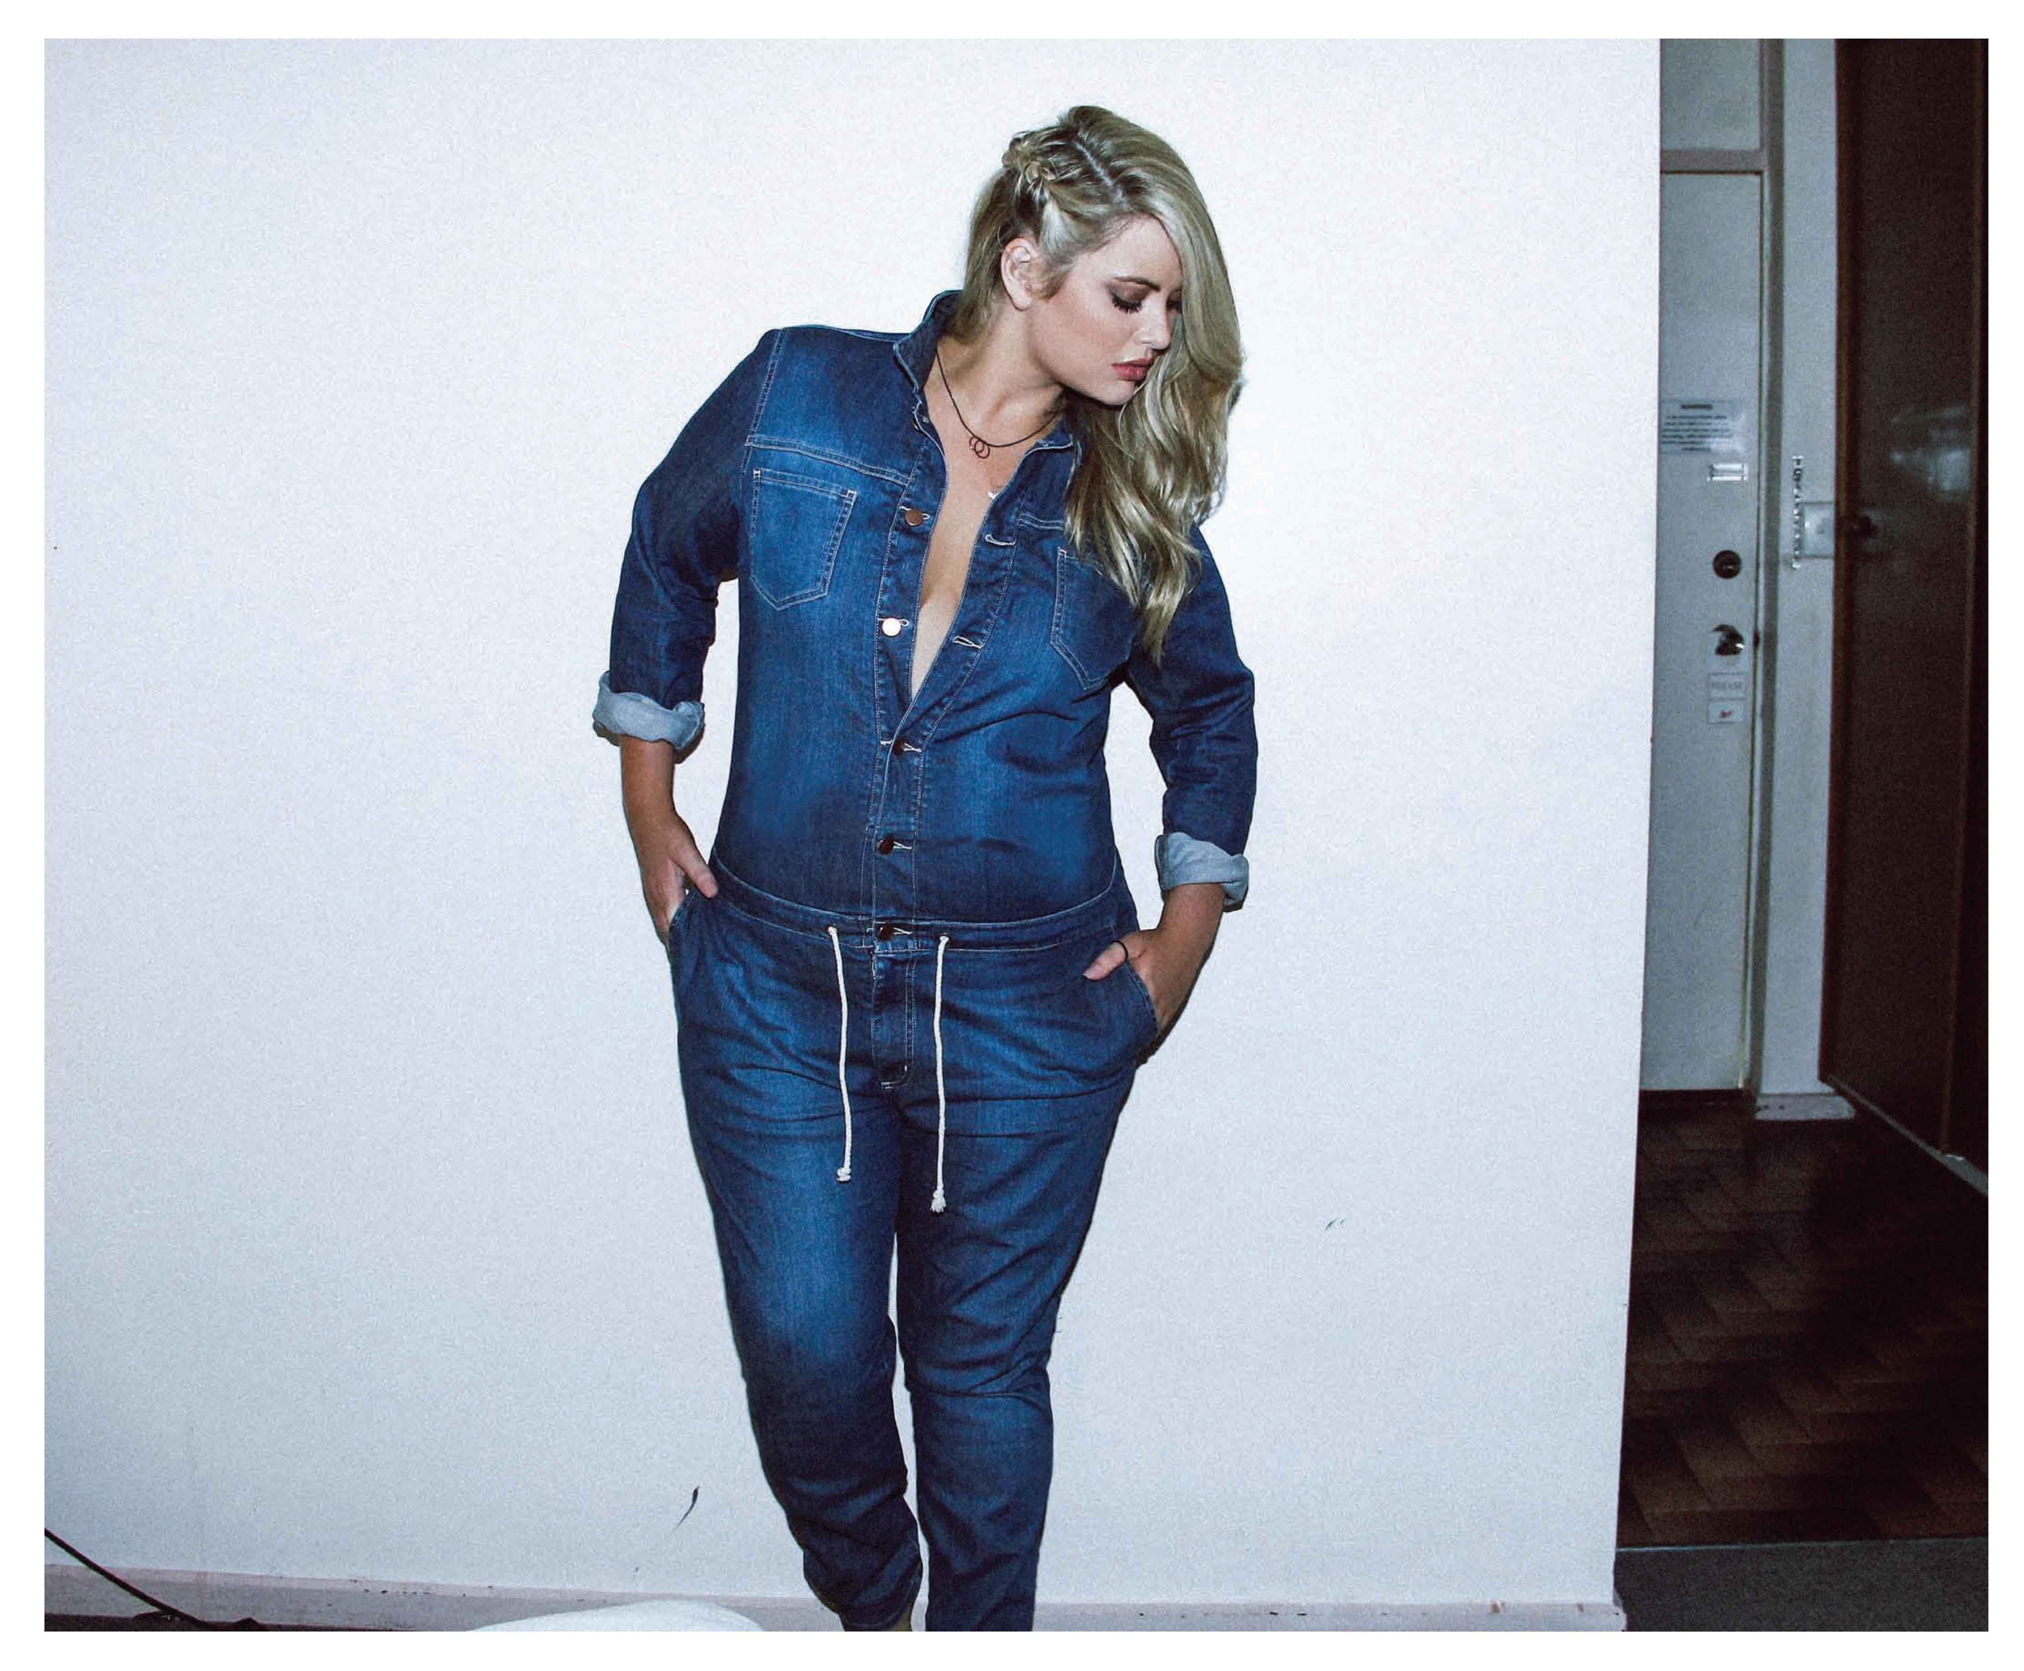
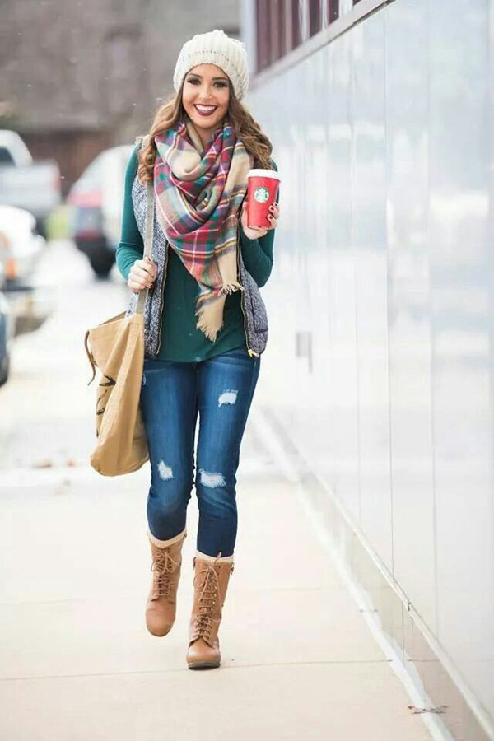
Autumn and winter waer ideas
A padded and loose denim coat
An overall maybe with poncho
A nice trousers with high waist
A simple but perfect denim jean with a scarf
Coat: long and thick,
with boots
Coat: short, padded and warm

Slide 6
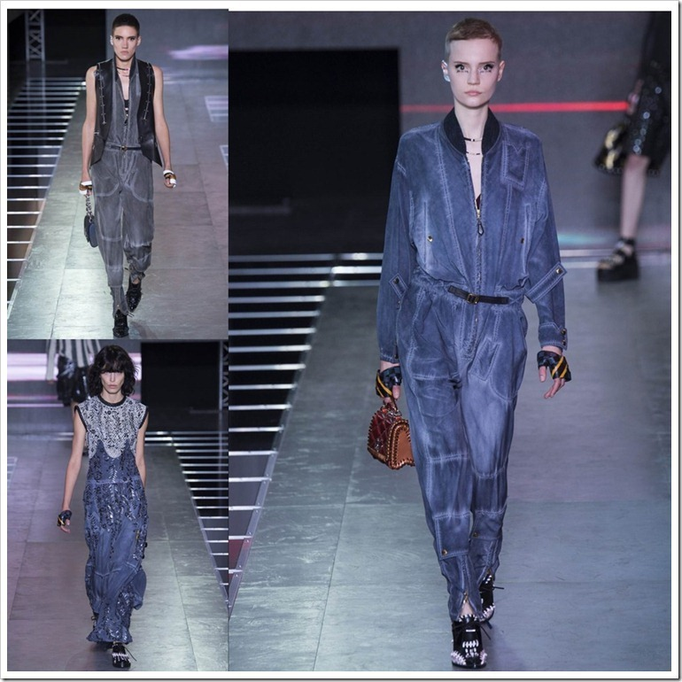
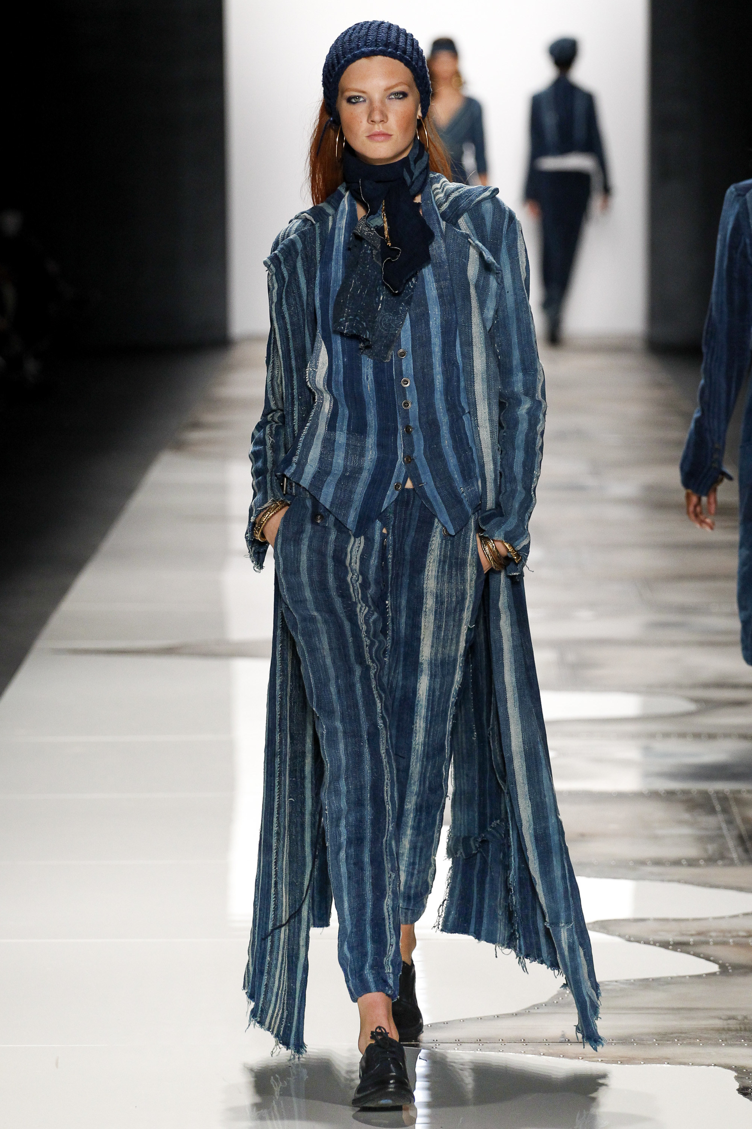
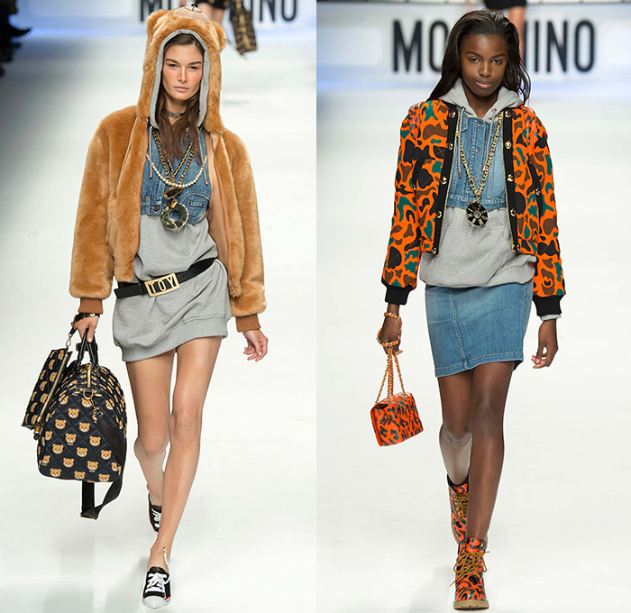
Designers love this material. Therefore these pictures from New York, Paris and Milan fashion week are the proof for it’s eternity.
Paris fashion week
DON’T: Wear a denim outfit that’s all the same weight or wash.
DON’T: Look to Westerns for inspiration.
DO: Play with colors if you’re a total beginner
DO: The dark brown accessories are very now add-ons for a denim dress.
Via: http://www.glamour.com/fashion/2009/07/the-dos-and-donts-of-wearing-denim/1
http://stylecaster.com/denim-on-denim-rules/
New York
fashion week
Milan fashion week

Slide 7
Please pick a pen or pencil and a paper!
Ready?
Please CLICK!

Slide 8
Quiz
1., What is the perfect day off?
a) Outdoor activities, sports, going to the gym is on the plan list
b) No matter what, being fashionable always helps to feel comfortable
c) Something extraordinary is always fun, maybe a picnic in the nature
4., Accessories
a) Bag, hat or nothing special
b) Shoes, handbags, anything that perfects the look
c) Something girly, inspired by your environment
2., Choose one!
a) Sporty, loose
b) Nice, elegant
c) Fresh, original
5., Which city?
a) Boston, Melbourn
b) New York, Washington
c) Paris, Los Angeles
3., Whose style is the best?
a) Rihanna
b) Victoria Beckham
c) Lucy Hale
Done? Please count your answers. Which one of them won?
Click!
a)
b)
c)

Slide 9
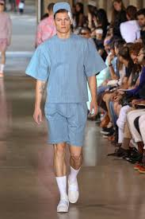
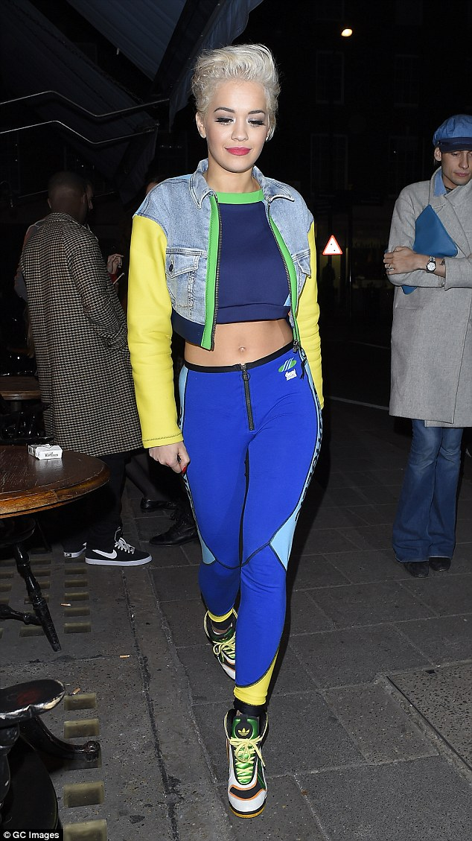
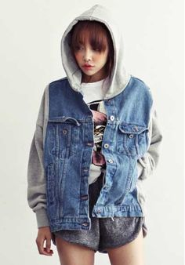
a)
Click

Slide 10
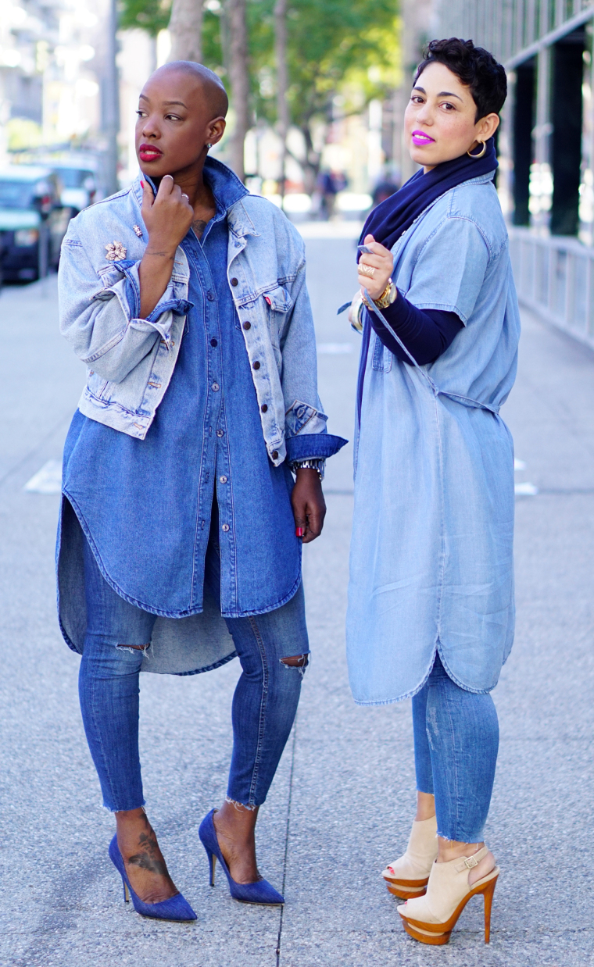
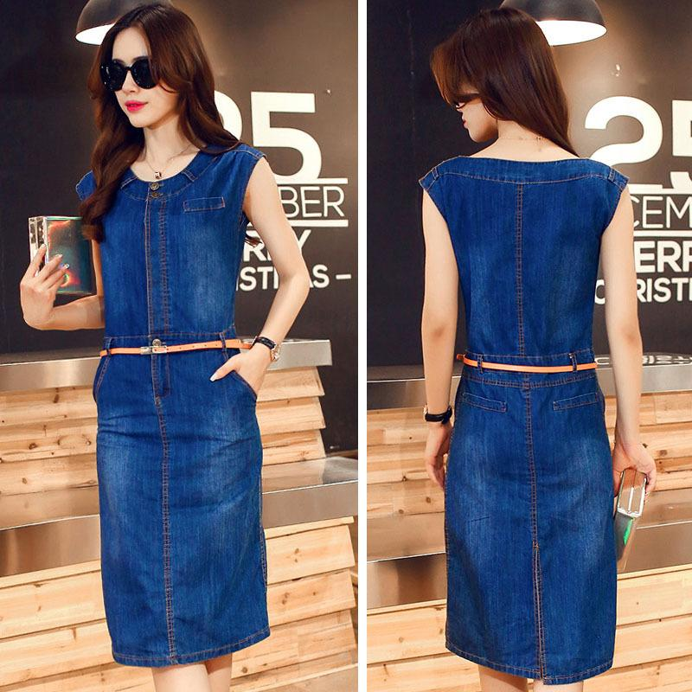
Click
b)

Slide 11
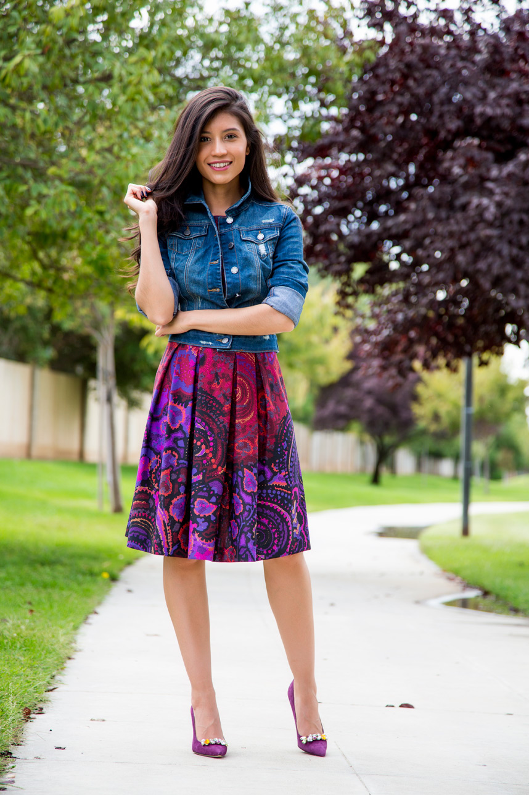
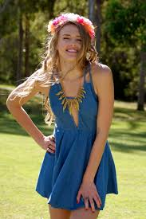
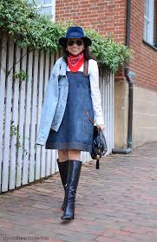
Click
c)

Slide 12
Thank you for your attention!
Zajácz Lili 8. évfolyam
Tiszavasvári Általános iskola

Slide 13
This presentation may include parts that are more feminine, but because of my gender I can freely talk only about this side of fashion and clothes.
☺

