Slide 1
Jeans in our days
Made by: Alexandra Szabó

Slide 2
Table of contents
The meaning of jeans
Why we like jeans
How we wear jeans
The biggest companies that make jeans
Jeans in the fashion world
Denim used in other ways
Jeans in my wardrobe

Slide 3
The meaning of jeans
From rebellion to one of the most liked things
Being elegant without extremes
Giving casuality to our outfits

Slide 4
Why we like jeans
Easy to wear them
They go with basically everything
They are really nice but comfortable as well

Slide 5
How we wear jeans
Jeans with jackets
In our daily life
From physical work to the offices

Slide 6
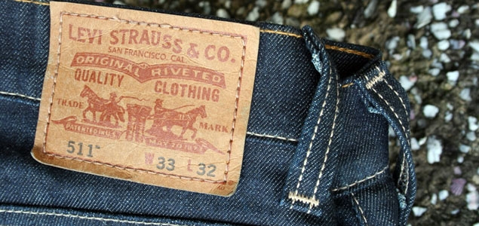
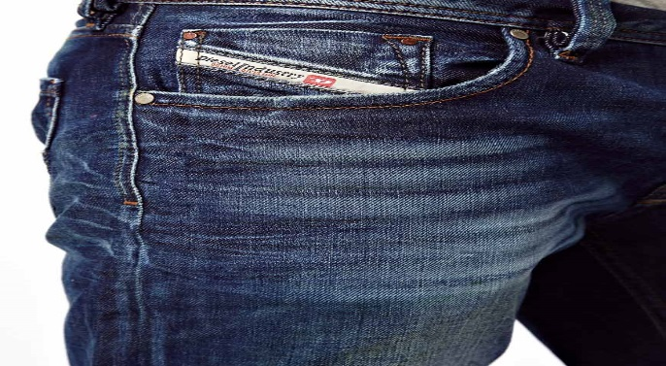
The biggest companies that make jeans
Levi’s - the original company the has made jeans
Diesel - founded by Benzo Rosso in the 1970’s
Retro Jeans Company

Slide 7
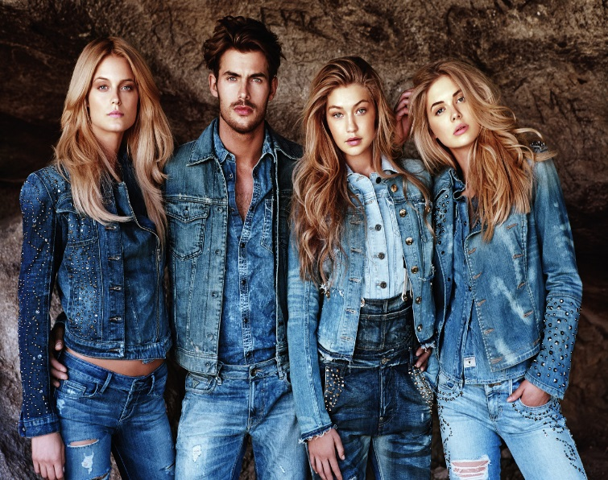
Jeans in the fashion world
Classic in fashion
Can’t get bored of it
Nothing has ever been this popular

Slide 8
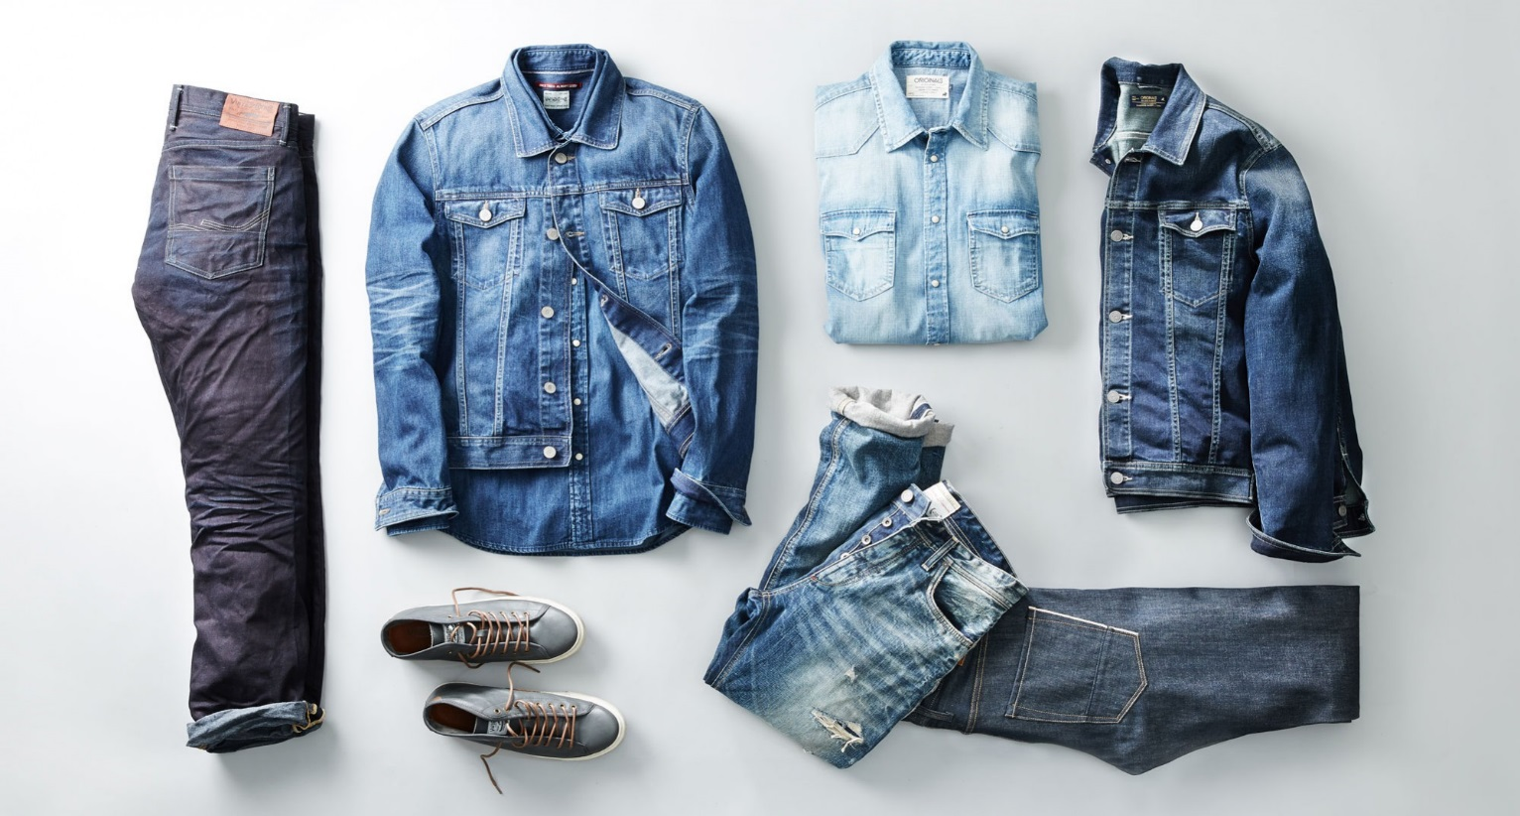
Denim used in other ways
Denim shorts - the short form of jeans
Denim skirts
Denim shirts and jackets

Slide 9
Jeans in my wardrobe
My favourite type of clothing
At least 20 pairs of jeans
Jackets, skirts and shorts made from denim
Something denim everyday

Slide 10
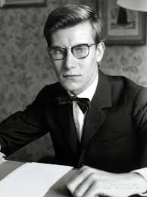
„I wish I had invented blue jeans. They have expression, modesty, sex appeal, simplicity - all I hope for in my clothes.”
-Yves Saint Laurent

